Slide 1
Unit – I Introduction Characteristics of a computer Generation of Computers

Slide 2
1- Speed
 Computer can work very fast .
 Computer can perform millions of instructions and even more per second.
 The speed of computer in terms of microsecond (10⁻⁶ part of second) or nanosecond (10⁻⁹ part of a second).

Slide 3
2- Accuracy
The degree of accuracy of computer is very high and every calculation is performed with the same accuracy.
The accuracy level is determined on the basis of design of computer.
The errors in computer are due to human and inaccurate data.
3- Diligence
A computer is a lack of concentration.
It can work for hours without creating any error
Due to this capability it overpowers human being in routine type of work.

Slide 4
4- Versatility
 It means the capacity to perform completely different type of work.
5-Power of Remembering
 Any amount of information can be stored in computer and recalled as long as you require it, for any numbers of years.
 It depends entirely upon you how much data you want to store in a computer and when to lose or retrieve these data.

Slide 5
6- No IQ (intelligence quotient)
 Computer is a dumb machine and it cannot do
any work without instruction from the user and it cannot take its own decision as you can.
No Feeling
 It does not have feelings ,
 it does not get tired even after long hours of work.
Storage
 The Computer has an in-built memory where it can store a large amount of data.
 You can also store data in secondary storage devices such as floppies, CDs Flash Memory
which can be kept outside your computer and can be carried to other computers.

Slide 6
Generation of Computers
Based on the characteristics of various computers developed from time to time, they are categorized as generation of computers.
Generation of Computers
First Generation
Second Generation
Third Generation
Fourth Generation
Fifth Generation

Slide 7
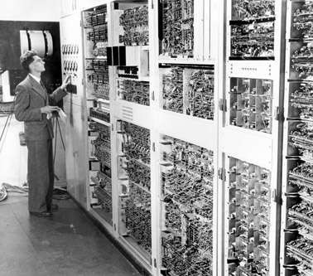
First Generation Computers
Time Period : 1951 to 1959
Size : Very Large System
Technology : Vacuum Tubes Processing : Very Slow
Characterized By:-
Magnetic Drums
Magnetic Tapes
Difficult to program
Used machine language & assembly language
First Generation Computers

Slide 8
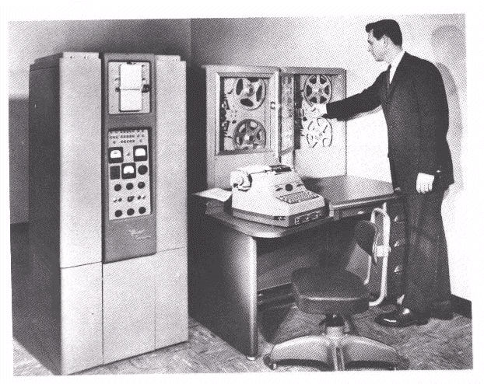
Second Generation Computers
Time Period : 1959 to 1963 Size : Smaller
Technology : Transistors Processing : Faster
Characterized By:-
Magnetic Cores
Magnetic Disk
Used high level language
Easier to program
Second Generation Computers

Slide 9
Third Generation Computers
Time Period
Technology
: 1963 to 1975
: ICs (Integrated Circuits)
Incorporated many transistors & electronic circuits on a single chip
: Small as compared to 2nd generation computers
: Faster then 2nd generation computers
Size Processing
Characterized by:-
Minicomputers accessible by multiple users from remote terminals.
IC (Integrated Circuit)

Slide 10
Fourth Generation Computers
Time Period Technology
: 1975 to Today
: VLSI (Very Large Scale Integration) Incorporated many millions of transistors & electronic circuits on a single chip
: Small as compared to first generation computer
: Faster then first generation computer
Size Processing
Characterized by:
The personal computer and user friendly micro-programs, very fast processor chip high level language, OOP (Object Oriented Programming)
VLSI (Very Large Scale Integration)

Slide 11
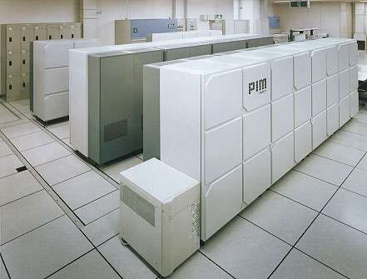
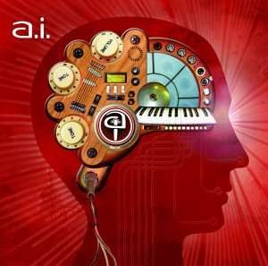
Fifth Generation Computers
Time Period Technology
: Future Technology
: AI (Artificial Intelligence)
AI (Artificial Intelligence)
Fifth Generation Computer

Slide 12
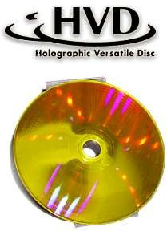
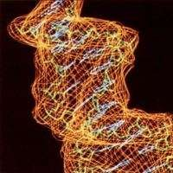
Next Generation Optical Disk
The following formats go beyond the current third-generation discs and have the potential to hold more than one terabyte (1TB) of data:
Holographic Versatile Disc (3.9TB=850 DVDs)
LS-R (Layer-Selection-Type Recordable Optical Disk)
Protein-coated disc

Slide 13
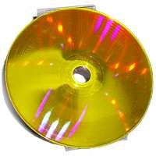
Holographic Versatile Disc
The Holographic Versatile
optical
Disc disc
(HVD) is
technology
an
still in the research
stage which would hold up to 3.9 terabytes (TB) of information
which is equivalent to 850 DVDs.
It was introduced in 2004.
around

Slide 14
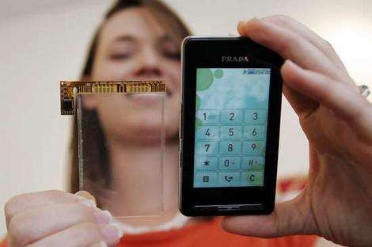
Future of Touch Screen
“The future of touch screen seems bright. A company named synaptics is developing a touch screen called 'ClearPad'. It is a thin, high resolution capacitive touch screen that can be placed on top of any display where a finger-touch is required. If this technology is mass-accepted then the need of mechanical keys will be eliminated.”

Slide 15
https://tinyurl.com/introductiontocomputer

